Slide 1
HTML/CSS Tutorial
MTM TRAINING AND CONSULTING GROUP | EMAIL: LEARNING@MTMCONSULTINGGROUP.COM | PHONE: 240-547-6851

Slide 2
Definitions
HTML stands for Hyper Text Markup Language
HTML describes the structure of Web pages using markup
HTML elements are the building blocks of HTML pages
HTML elements are represented by tags
HTML tags label pieces of content such as "heading", "paragraph", "table", and so on
Browsers do not display the HTML tags, but use them to render the content of the page
MTM TRAINING AND CONSULTING GROUP | EMAIL: LEARNING@MTMCONSULTINGGROUP.COM | PHONE: 240-547-6851

Slide 3
HTML Page Format
<!DOCTYPE html>
<HTML>
<HEAD>
<TITLE> Page Title</TITLE>
</HEAD>
<BODY>
<H1> My First Heading</H1>
<!-- Rest of page goes here. My First Comment. -->
<P>My First Paragraph</P>
</BODY>
</HTML>
MTM TRAINING AND CONSULTING GROUP | EMAIL: LEARNING@MTMCONSULTINGGROUP.COM | PHONE: 240-547-6851
Notes:
The <!DOCTYPE html> declaration defines this document to be HTML5
The <html> element is the root element of an HTML page
The <head> element contains meta information about the document
The <title> element specifies a title for the document
The <body> element contains the visible page content
The <h1> element defines a large heading
The <p> element defines a paragraph

Slide 4
HTML Tags
HTML tags are element names surrounded by angle brackets:
<tagname tagAttribute=“TagAttributeValue”>content goes here...</tagname>
HTML tags normally come in pairs like <p> and </p>
The first tag in a pair is the start tag (opening tag), the second tag is the end tag(closing tag)
The end tag is written like the start tag, but with a forward slash inserted before the tag name
MTM TRAINING AND CONSULTING GROUP | EMAIL: LEARNING@MTMCONSULTINGGROUP.COM | PHONE: 240-547-6851

Slide 5
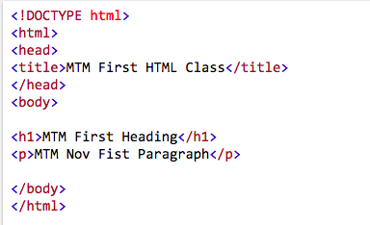
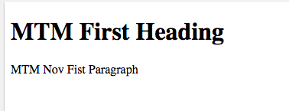
Web Browsers
The purpose of a web browser (Chrome, IE, Firefox, Safari) is to read HTML documents and display them.
The browser does not display the HTML tags, but uses them to determine how to display the document:
MTM TRAINING AND CONSULTING GROUP | EMAIL: LEARNING@MTMCONSULTINGGROUP.COM | PHONE: 240-547-6851

Slide 6
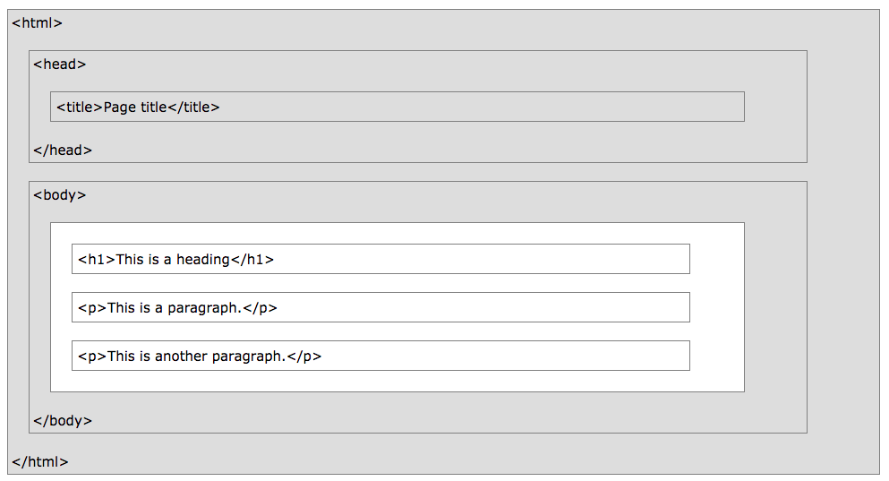
HTML Page Structure
MTM TRAINING AND CONSULTING GROUP | EMAIL: LEARNING@MTMCONSULTINGGROUP.COM | PHONE: 240-547-6851
Notes:
Visualization of the HTML page Structure
Note: Only the content inside the <body> section (the white area above) is displayed in a browser.

Slide 7
HTML Versions
  Version Year
  HTML 1991
  HTML 2.0 1995
  HTML 3.2 1997
  HTML 4.01 1999
  XHTML 2000
  HTML5 2014
MTM TRAINING AND CONSULTING GROUP | EMAIL: LEARNING@MTMCONSULTINGGROUP.COM | PHONE: 240-547-6851

Slide 8
Lab Exercise
  Create our first HTML Using Notepad or TextEdit
  Learn Basic HTML Tags
    Headings
    Paragraphs
    Links
    Images
    Tables (table, th, tr, td)
    Div
    Span
    Note: Do Not Forget the End Tag
MTM TRAINING AND CONSULTING GROUP | EMAIL: LEARNING@MTMCONSULTINGGROUP.COM | PHONE: 240-547-6851

Slide 9
BODY Element
<BODY attributename="attributevalue">
Deprecated attributes (but still used)
  BACKGROUND=“Sunset.jpg” (can be tiled)
  BGCOLOR=color
  TEXT=color
  LINK=color (unvisited links)
  VLINK=color (visited links)
  ALINK=color (when selected)
MTM TRAINING AND CONSULTING GROUP | EMAIL: LEARNING@MTMCONSULTINGGROUP.COM | PHONE: 240-547-6851

Slide 10
Headings
  <H1 ...> text </H1> -- largest of the six
  <H2 ...> text </H2>
  <H3 ...> text </H3>
  <H4 ...> text </H4>
  <H5 ...> text </H5>
  <H6 ...> text </H6> -- smallest of the six
ALIGN="position" --left (default), center or right
MTM TRAINING AND CONSULTING GROUP | EMAIL: LEARNING@MTMCONSULTINGGROUP.COM | PHONE: 240-547-6851

Slide 11
Headings
<HTML>
<HEAD>
<TITLE>Document Headings</TITLE>
</HEAD>
<BODY>
Samples of the six heading types:
<H1>Level-1 (H1)</H1>
<H2 ALIGN="center">Level-2 (H2)</H2>
<H3><U>Level-3 (H3)</U></H3>
<H4 ALIGN="right">Level-4 (H4)</H4>
<H5>Level-5 (H5)</H5>
<H6>Level-6 (H6)</H6>
</BODY>
</HTML>
MTM TRAINING AND CONSULTING GROUP | EMAIL: LEARNING@MTMCONSULTINGGROUP.COM | PHONE: 240-547-6851

Slide 12
<P> Paragraph
<P> defines a paragraph
Add ALIGN="position" (left, center, right)
Multiple <P>'s do not create blank lines
Use <BR> for blank line
Fully-specified text uses <P> and </P>
But </P> is optional
MTM TRAINING AND CONSULTING GROUP | EMAIL: LEARNING@MTMCONSULTINGGROUP.COM | PHONE: 240-547-6851

Slide 13
<BODY>
<P>Here is some text </P>
<P ALIGN="center"> Centered text </P>
<P><P><P>
<P ALIGN="right"> Right-justified text
<! Note: no closing /P tag is not a problem>
</BODY>
MTM TRAINING AND CONSULTING GROUP | EMAIL: LEARNING@MTMCONSULTINGGROUP.COM | PHONE: 240-547-6851

Slide 14
<PRE> Preformatted Text
<PRE>
if (a < b) {
a++;
b = c * d;
}
else {
a--;
b = (b-1)/2;
}
</PRE>
MTM TRAINING AND CONSULTING GROUP | EMAIL: LEARNING@MTMCONSULTINGGROUP.COM | PHONE: 240-547-6851

Slide 15
Special Characters
Character | Use
< | &lt;
> | &gt;
& | &amp;
" | &quot;
Space | &nbsp;
MTM TRAINING AND CONSULTING GROUP | EMAIL: LEARNING@MTMCONSULTINGGROUP.COM | PHONE: 240-547-6851

Slide 16
Colors
Values for BGCOLOR and COLOR
  many are predefined (red, blue, green, ...)
  all colors can be specified as a six character hexadecimal value: RRGGBB
  FF0000 – red
  888888 – gray
  004400 – dark green
  FFFF00 – yellow
MTM TRAINING AND CONSULTING GROUP | EMAIL: LEARNING@MTMCONSULTINGGROUP.COM | PHONE: 240-547-6851

Slide 17
Fonts
<FONT COLOR="red" SIZE="2" FACE="Times Roman">
This is the text of line one </FONT>
<FONT COLOR="green" SIZE="4" FACE="Arial">
Line two contains this text </FONT>
<FONT COLOR="blue" SIZE="6" FACE="Courier"
The third line has this additional text </FONT>
Note: <FONT> is now deprecated in favor of CSS.
MTM TRAINING AND CONSULTING GROUP | EMAIL: LEARNING@MTMCONSULTINGGROUP.COM | PHONE: 240-547-6851

Slide 18
Ordered (Numbered) Lists
<OL TYPE="1">
<LI> Item one </LI>
<LI> Item two </LI>
<OL TYPE="I" >
<LI> Sublist item one </LI>
<LI> Sublist item two </LI>
<OL TYPE="i">
<LI> Sub-sublist item one </LI>
<LI> Sub-sublist item two </LI>
</OL>
</OL>
</OL>
MTM TRAINING AND CONSULTING GROUP | EMAIL: LEARNING@MTMCONSULTINGGROUP.COM | PHONE: 240-547-6851

Slide 19
Unordered (Bulleted) Lists
<UL TYPE="disc">
<LI> One </LI>
<LI> Two </LI>
<UL TYPE="circle">
<LI> Three </LI>
<LI> Four </LI>
<UL TYPE="square">
<LI> Five </LI>
<LI> Six </LI>
</UL>
</UL>
</UL>
MTM TRAINING AND CONSULTING GROUP | EMAIL: LEARNING@MTMCONSULTINGGROUP.COM | PHONE: 240-547-6851

Slide 20
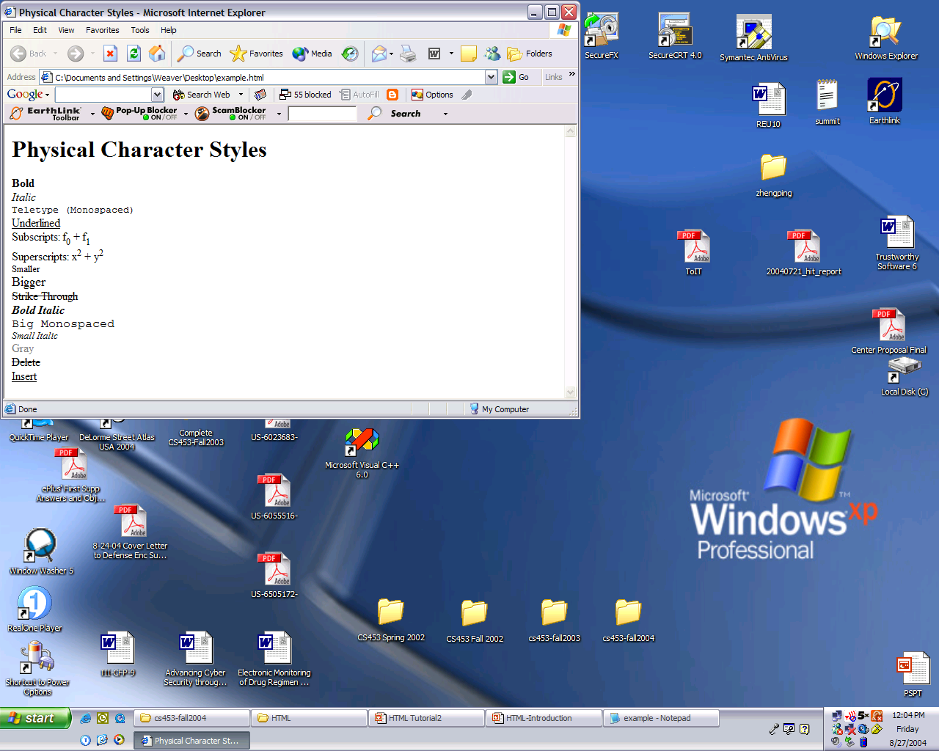
Physical Character Styles
<H1>Physical Character Styles</H1>
<B>Bold</B><BR>
<I>Italic</I><BR>
<TT>Teletype (Monospaced)</TT><BR>
<U>Underlined</U><BR>
Subscripts: f<SUB>0</SUB> + f<SUB>1</SUB><BR>
Superscripts: x<SUP>2</SUP> + y<SUP>2</SUP><BR>
<SMALL>Smaller</SMALL><BR>
<BIG>Bigger</BIG><BR>
<STRIKE>Strike Through</STRIKE><BR>
<B><I>Bold Italic</I></B><BR>
<BIG><TT>Big Monospaced</TT></BIG><BR>
<SMALL><I>Small Italic</I></SMALL><BR>
<FONT COLOR="GRAY">Gray</FONT><BR>
<DEL>Delete</DEL><BR>
<INS>Insert</INS><BR>
MTM TRAINING AND CONSULTING GROUP | EMAIL: LEARNING@MTMCONSULTINGGROUP.COM | PHONE: 240-547-6851

Slide 21
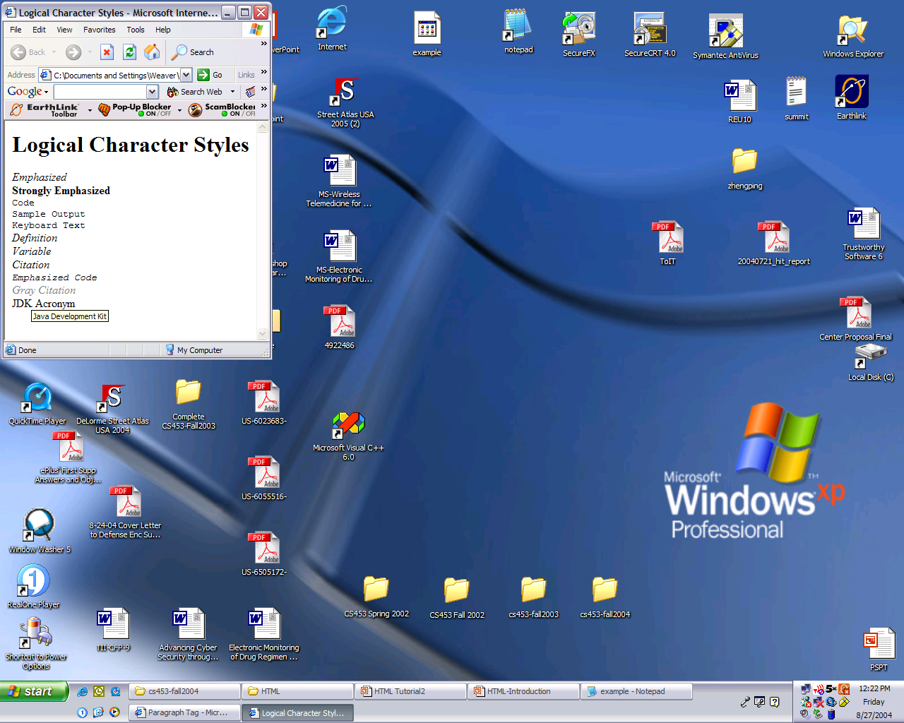
Logical
Character
Styles
<H1>Logical Character Styles</H1>
<EM>Emphasized</EM><BR>
<STRONG>Strongly Emphasized</STRONG><BR>
<CODE>Code</CODE><BR>
<SAMP>Sample Output</SAMP><BR>
<KBD>Keyboard Text</KBD><BR>
<DFN>Definition</DFN><BR>
<VAR>Variable</VAR><BR>
<CITE>Citation</CITE><BR>
<EM><CODE>Emphasized Code</CODE></EM><BR>
<FONT COLOR="GRAY"><CITE>Gray Citation</CITE></FONT><BR>
<ACRONYM TITLE="Java Development Kit">JDK Acronym</ACRONYM>
MTM TRAINING AND CONSULTING GROUP | EMAIL: LEARNING@MTMCONSULTINGGROUP.COM | PHONE: 240-547-6851

Slide 22
<A> Anchors (HyperLinks)
Link to an absolute URL:
If you get spam, contact <A HREF="htttp:www.microsoft.com">
Microsoft </A> to report the problem.
Link to a relative URL:
See these <A HREF="#references"> references </A>
concerning our fine products.
Link to a section within a URL:
Amazon provided a <A HREF="www.amazon.com/#reference">
reference for our company. </A>
MTM TRAINING AND CONSULTING GROUP | EMAIL: LEARNING@MTMCONSULTINGGROUP.COM | PHONE: 240-547-6851

Slide 23
Naming a Section
<H2> <A NAME="#references"> Our References </A> </H2>
Example
MTM TRAINING AND CONSULTING GROUP | EMAIL: LEARNING@MTMCONSULTINGGROUP.COM | PHONE: 240-547-6851

Slide 24
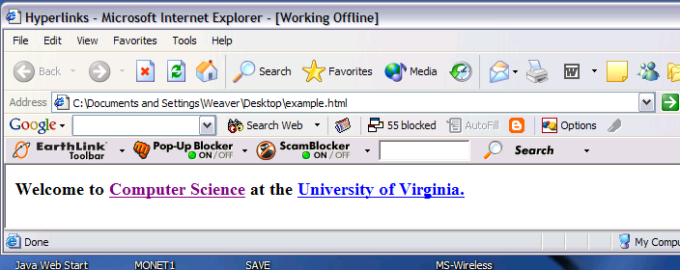
Hyperlinks
<BODY>
<H3>Welcome to <A HREF="http://www.cs.virginia.edu">
<STRONG>Computer Science</STRONG></A>
at the <A HREF="www.virginia.edu">University of Virginia.</A>
</H3>
</BODY>
MTM TRAINING AND CONSULTING GROUP | EMAIL: LEARNING@MTMCONSULTINGGROUP.COM | PHONE: 240-547-6851

Slide 25
Images
SRC is required
WIDTH, HEIGHT may be in units of pixels or percentage of page or frame
  WIDTH="357"
  HEIGHT="50%"
Images scale to fit the space allowed
MTM TRAINING AND CONSULTING GROUP | EMAIL: LEARNING@MTMCONSULTINGGROUP.COM | PHONE: 240-547-6851

Slide 26
Images
Align=position | Image/Text Placement
Left | Image on left edge; text flows to right of image
Right | Image on right edge; text flows to left
Top | Image is left; words align with top of image
Bottom | Image is left; words align with bottom of image
Middle | Words align with middle of image
MTM TRAINING AND CONSULTING GROUP | EMAIL: LEARNING@MTMCONSULTINGGROUP.COM | PHONE: 240-547-6851

Slide 27
Images
<BODY>
<img src="dolphin.jpg" align="left" width="150" height="150" alt="dolphin jump!">
This is a very cute dolphin on the left!<br>
This is a very cute dolphin on the left!<br>
This is a very cute dolphin on the left!<br>
This is a very cute dolphin on the left!<br>
This is a very cute dolphin on the left!<br>
This is a very cute dolphin on the left!<br>
This is a very cute dolphin on the left!<br>
This is a very cute dolphin on the left!<br>
This is a very cute dolphin on the left!<br>
This is a very cute dolphin on the left!<br>
You can see text wrap around it<br>
</BODY>
</HTML>
MTM TRAINING AND CONSULTING GROUP | EMAIL: LEARNING@MTMCONSULTINGGROUP.COM | PHONE: 240-547-6851

Slide 28
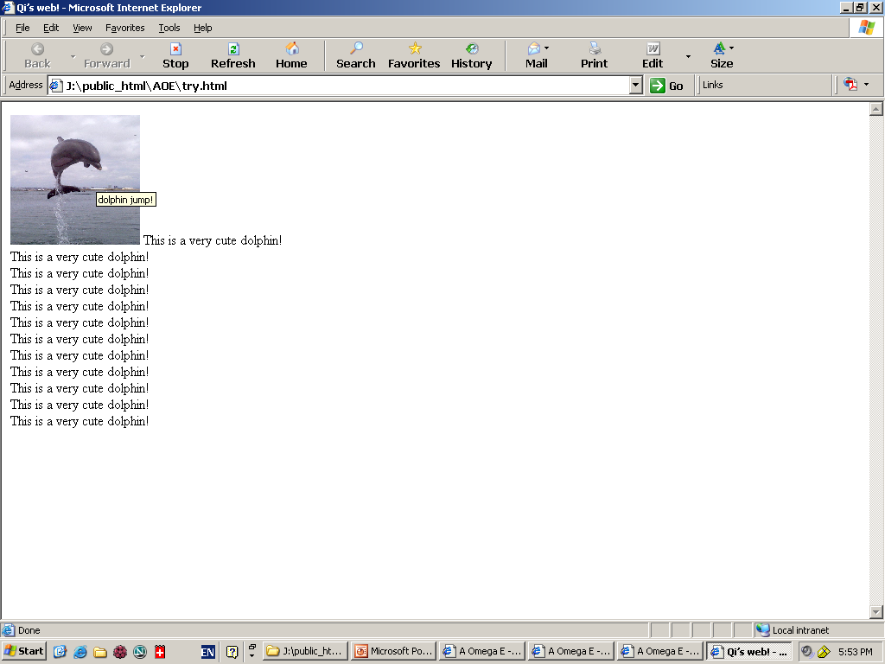
ALIGN="left"
MTM TRAINING AND CONSULTING GROUP | EMAIL: LEARNING@MTMCONSULTINGGROUP.COM | PHONE: 240-547-6851

Slide 29
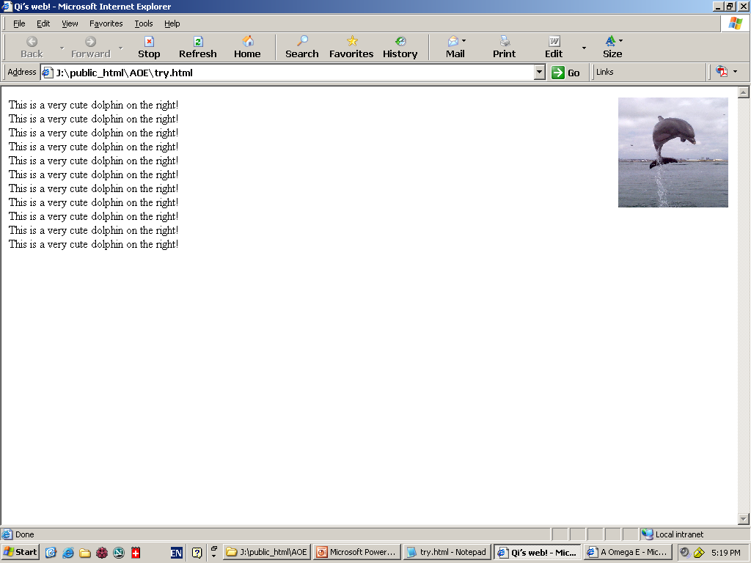
ALIGN="right"
MTM TRAINING AND CONSULTING GROUP | EMAIL: LEARNING@MTMCONSULTINGGROUP.COM | PHONE: 240-547-6851

Slide 30
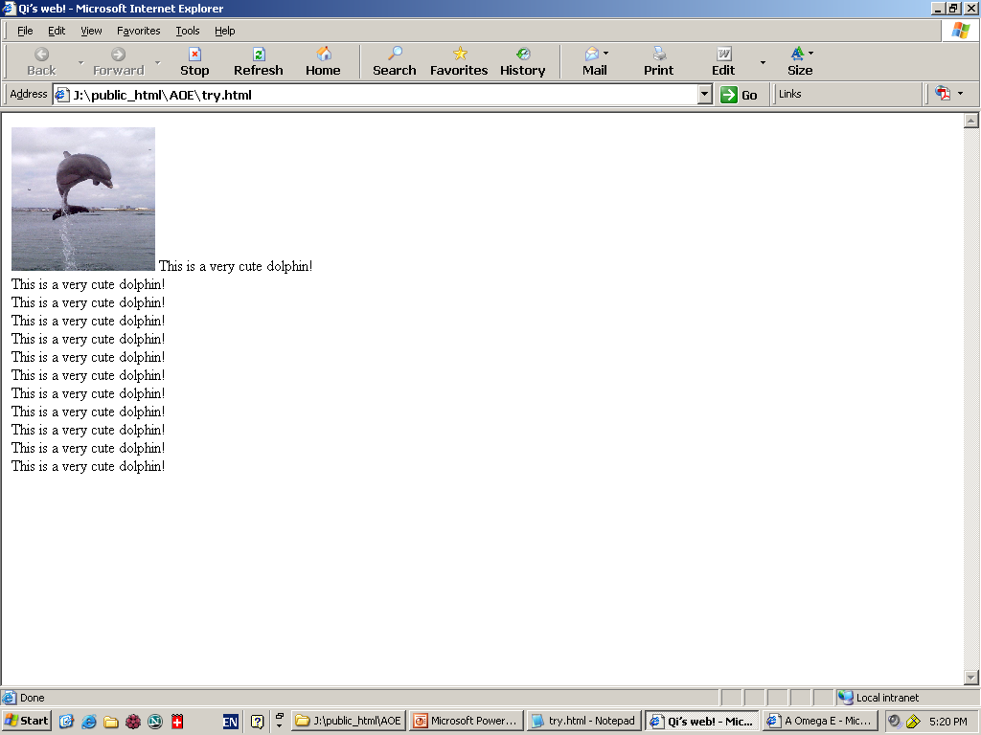
ALIGN=“bottom"
MTM TRAINING AND CONSULTING GROUP | EMAIL: LEARNING@MTMCONSULTINGGROUP.COM | PHONE: 240-547-6851

Slide 31
Tables
<TABLE> table tag
<CAPTION> optional table title
<TR> table row
<TH> table column header
<TD> table data element
MTM TRAINING AND CONSULTING GROUP | EMAIL: LEARNING@MTMCONSULTINGGROUP.COM | PHONE: 240-547-6851

Slide 32
Tables
  <TABLE BORDER=1>
  <CAPTION>Table Caption</CAPTION>
  <TR><TH>Heading1</TH> <TH>Heading2</TH></TR>
  <TR><TD>Row1 Col1 Data</TD><TD>Row1 Col2 Data</TD></TR>
  <TR><TD>Row2 Col1 Data</TD><TD>Row2 Col2 Data</TD></TR>
  <TR><TD>Row3 Col1 Data</TD><TD>Row3 Col2 Data</TD></TR>
  </TABLE>
MTM TRAINING AND CONSULTING GROUP | EMAIL: LEARNING@MTMCONSULTINGGROUP.COM | PHONE: 240-547-6851

Slide 33
<TABLE> Element Attributes
ALIGN=position -- left, center, right for table
BORDER=number -- width in pixels of border (including any cell spacing, default 0)
CELLSPACING=number -- spacing in pixels between cells, default about 3
CELLPADDING=number -- space in pixels between cell border and table element, default about 1
WIDTH=number[%]-- width in pixels or percentage of page/frame width
MTM TRAINING AND CONSULTING GROUP | EMAIL: LEARNING@MTMCONSULTINGGROUP.COM | PHONE: 240-547-6851

Slide 34
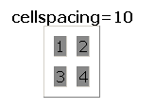
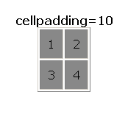
cellspacing=10
cellpadding=10
MTM TRAINING AND CONSULTING GROUP | EMAIL: LEARNING@MTMCONSULTINGGROUP.COM | PHONE: 240-547-6851

Slide 35
<TABLE> Element Attributes
BGCOLOR=color -- background color of table, also valid
for <TR>, <TH>, and <TD>
RULES=value -- which internal lines are shown; values are
none, rows, cols, and all (default)
EX: <TABLE COLS=“40%, *,*”>
<TABLE ROWS=“*,*”>
MTM TRAINING AND CONSULTING GROUP | EMAIL: LEARNING@MTMCONSULTINGGROUP.COM | PHONE: 240-547-6851

Slide 36
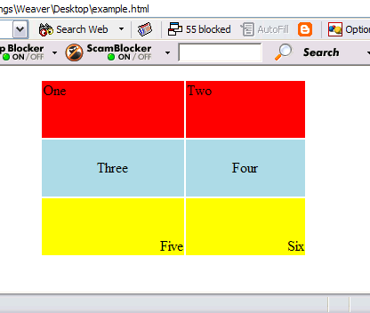
<TR> Table Row Attributes
Valid for the table row:
ALIGN -- left, center, right
VALIGN -- top, middle, bottom
BGCOLOR -- background color
<TABLE ALIGN="center" WIDTH="300" HEIGHT="200">
<TR ALIGN="left" VALIGN="top" BGCOLOR="red"><TD>One</TD><TD>Two</TD>
<TR ALIGN="center" VALIGN="middle" BGCOLOR="lightblue"><TD>Three</TD><TD>Four</TD>
<TR ALIGN="right" VALIGN="bottom" BGCOLOR="yellow"><TD>Five</TD><TD>Six</TD>
</TABLE>
MTM TRAINING AND CONSULTING GROUP | EMAIL: LEARNING@MTMCONSULTINGGROUP.COM | PHONE: 240-547-6851

Slide 37
<TD> Table Cell Attributes
Valid for the table cell:
colspan -- how many columns this cell occupies
rowspan – how many rows this cell occupies
<TABLE ALIGN="center" WIDTH="300" HEIGHT="200" border="1">
<TR>
<TD colspan="1" rowspan="2">a</TD>
<TD colspan="1" rowspan="1">b</TD>
</TR>
<TR>
<TD colspan="1" rowspan="1">c</TD>
</TR>
</TABLE>
MTM TRAINING AND CONSULTING GROUP | EMAIL: LEARNING@MTMCONSULTINGGROUP.COM | PHONE: 240-547-6851

Slide 38
Frames
Frames help control navigation and display
<FRAME> attributes include
  FRAMEBORDER – yes or 1 for borders
  FRAMESPACING – width of border
  BORDERCOLOR – color
  SRC – location of HTML to display in frame
  NAME – destination for TARGET attribute
MTM TRAINING AND CONSULTING GROUP | EMAIL: LEARNING@MTMCONSULTINGGROUP.COM | PHONE: 240-547-6851

Slide 39
Frames
  MARGINWIDTH – left/right margins
  MARGINHEIGHT – top/bottom margins
  SCROLLING – yes or 1 adds scroll bar
  NORESIZE – yes or 1 disables resizing
MTM TRAINING AND CONSULTING GROUP | EMAIL: LEARNING@MTMCONSULTINGGROUP.COM | PHONE: 240-547-6851

Slide 40
Frames
<FRAMESET ROWS="75%,25%">
<FRAMESET COLS="*,*,*">
<FRAME SRC="http://www.virginia.edu">
<FRAME SRC="http://www.virginia.edu">
<FRAME SRC="http://www.virginia.edu">
</FRAMESET>
<FRAMESET COLS="*,*">
<FRAME SRC="http://www.virginia.edu">
<FRAME SRC="http://www.virginia.edu">
</FRAMESET>
</FRAMESET>
MTM TRAINING AND CONSULTING GROUP | EMAIL: LEARNING@MTMCONSULTINGGROUP.COM | PHONE: 240-547-6851

Slide 41
Frames
<FRAMESET ROWS="25%,75%"
<FRAMESET COLS="*,*,*">
<FRAME SRC="http://www.virginia.edu">
<FRAME SRC="http://www.virginia.edu">
<FRAME SRC="http://www.virginia.edu">
</FRAMESET>
<FRAMESET COLS="*,*">
<FRAME SRC="http://www.virginia.edu">
<FRAME SRC="http://www.virginia.edu">
</FRAMESET>
</FRAMESET>
MTM TRAINING AND CONSULTING GROUP | EMAIL: LEARNING@MTMCONSULTINGGROUP.COM | PHONE: 240-547-6851

Slide 42
Frames
<FRAMESET ROWS="*,*">
<FRAMESET COLS="15%, 2*, *">
<FRAME SRC="http://www.cs.virginia.edu/">
<FRAME SRC="http://www.cs.virginia.edu/">
<FRAME SRC="http://www.cs.virginia.edu/">
</FRAMESET>
<FRAMESET COLS="40%, *">
<FRAME SRC="http://www.cs.virginia.edu/">
<FRAME SRC="http://www.cs.virginia.edu/">
</FRAMESET>
</FRAMESET>
MTM TRAINING AND CONSULTING GROUP | EMAIL: LEARNING@MTMCONSULTINGGROUP.COM | PHONE: 240-547-6851

Slide 43
List
Unordered HTML List
An unordered list starts with the <ul> tag. Each list item starts with the <li> tag.
The list items will be marked with bullets (small black circles) by default:
Example
<ul>
<li>Coffee</li>
<li>Tea</li>
<li>Milk</li>
</ul>
MTM TRAINING AND CONSULTING GROUP | EMAIL: LEARNING@MTMCONSULTINGGROUP.COM | PHONE: 240-547-6851

Slide 44
Ordered HTML List - The Type Attribute
The type attribute of the <ol> tag, defines the type of the list item marker:
Numbers:
<ol type="1">
<li>Coffee</li>
<li>Tea</li>
<li>Milk</li>
</ol>
MTM TRAINING AND CONSULTING GROUP | EMAIL: LEARNING@MTMCONSULTINGGROUP.COM | PHONE: 240-547-6851

